Slide 1
Chap 2: Data types, Operators and Expressions
Lecture 1: Data types-1

Slide 2
1 Introduction
2 Character Set
3 Keywords and identifiers
4 Primary data types
5 Variables
6 Constants
Notes:
程序功能是否强大的依据？
程序设计语言类型丰富、
操作符全面

Slide 3
1 Introduction
A program, composed of precise instructions, is to achieve the task of processing data (computation).
Computation, the third pillar to science and technology, is central to your studies in the coming three years.
The precise instructions are formed using certain symbols and words according to some rigid rules known as syntax rules (or grammar).
This lecture might be a bit boring due to a bunch of rules but it is essential and sometimes critical for writing a ‘correct’ program.

Slide 4
Flow chart of developing C
Start
Edit
.C
Source Program
Compile
Y
Errors?
.OBJ
Object Program
N
System Library and Other Object Program
Link
Y
.EXE
Executive Program
Errors?
N
Execute
N
Result Right？
Y
Process
End

Slide 5
1 Introduction
2 Character Set
3 Keywords and identifiers
4 Primary data types
5 Variables
6 Constants
Notes:
程序功能是否强大的依据？
程序设计语言类型丰富、
操作符全面

Slide 6
2 Character Set
The characters in C are grouped into the following four categories: Letters，Digits， Special characters，White spaces
Letters
A……Z a……z
Digits
0……9
Special characters： 29 graphic characters
, & . ^ ; * : - ? + ‘ < …
C programs differ upper and lower case letters.
Lowercase letter，uppercase letter
capital letter

Slide 7
Append.: Symbols & English
Symbols English
# number sign
, comma
. dot(period)
_ underscore
- dash(minus, subtract)
( parentheses [pəˈrenθəsiːz]
: colon
; semicolon
[ left bracket
] right bracket
{ left brace
} right brace
| vertical bar
\ back slash
Symbols English
! exclamation
$ dollar sign
% percent sign
& and (ampersand)
* star (asterisk)
‘ single quote
“ double quote
^ caret
~ tilde [ˈtɪldə]
Notes:
# the pound key

Slide 8
Character Set
White spaces
Blank space Horizontal tab Carriage return (New line)

Slide 9
1 Introduction
2 Character Set
3 Keywords and identifiers
4 Primary data types
5 Variables
6 Constants
Notes:
程序功能是否强大的依据？
程序设计语言类型丰富、
操作符全面

Slide 10
3 Keywords and identifiers
C Keywords
Have special meanings for certain instruction
Serve as basic building blocks for program statements
Do NOT need to memorize them for now as you will use them all the time later
auto break case char const
continue default do double else
enum extern float for goto
if int long register return
short signed sizeof static struct
switch typedef unsigned union void
volatile while
All keywords have a fixed meaning that cannot be changed, and must be lowercase.
The user-defined identifier cannot be the same as the keyword.

Slide 11
3 Keywords and identifiers
Identifiers refer to names of variables and functions.
Identifiers are user-defined names consist of a sequence of letters and digits, with a letter as first character.
An identifier to be unique in its scope.
Examples (legal or illegal)
The underscore _ counts as a letter
Rules for Identifiers
First character must be a letter (or underscore).
Must consist of only letters, digits or underscore.
Only first 31 characters are significant.
Cannot use a keyword.
Must NOT contain white space.
Legal but not recommend
Identifiers should be able to "see the name to know the meaning";
sum Sum M.D.John day Date 3days
student_name #33 lotus_1_2_3
char a>b _above $123

Slide 12
1 Introduction
2 Character Set
3 Keywords and identifiers
4 Primary data types
5 Variables
6 Constants
Notes:
程序功能是否强大的依据？
程序设计语言类型丰富、
操作符全面

Slide 13
4 Primary data types
4 Primary data types
4.1 introduction
4.2 integer type
4.3 float type
4.4 char type

Slide 14
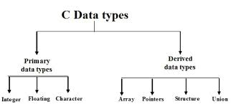
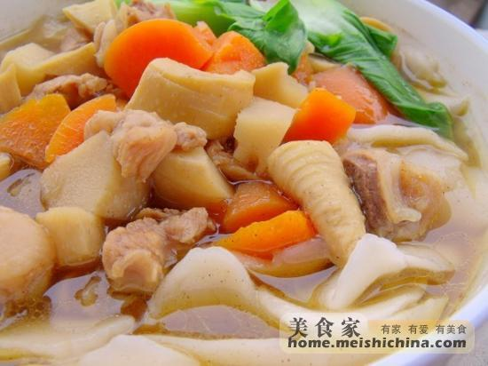
4.1 Primary data types introduction
Type (TYPE) is an abstraction of data that defines a set of data and the operations defined within that set of data;
Data of the same type has the same representation, storage format and related operations;
All data in a program must belong to some type of data.
This chapter focuses on basic data types, while other data types will be covered in more detail in subsequent chapters.

Slide 15
4.1 Primary data types introduction
PRIMARY DATA TYPES
Integral Type
Integer
Character
Singed unsigned type
int unsigned int
short int unsigned short int
long int unsigned long int
char
singed char
unsigned char
Floating point Type
float double Long double
void

Slide 16
4 Primary data types
4 Primary data types
4.1 introduction
4.2 integer type
4.3 float type
4.4 char type

Slide 17
4.2 Integer type
a data type that represents some range of mathematical integers.
Integral types may be
unsigned (capable of representing only non-negative integers)
or
signed (capable of representing negative integers as well).
0

Slide 18
4.2 Integer type
type | bytes | limit
short [int] | 2 | -(2⁻¹⁵)～2¹⁵-1: -32768～32767
signed short [int] | 2 | -32768～32767
unsigned short [int] | 2 | 0～2¹⁶-1 : 0～65535
int | 4 | -(2³¹)～2³¹-1:-2147483648～ 2147483647
signed [int] | 4 | -2147483648～ 2147483647
unsigned [int] | 4 | 0～2³²-1: 0～4294967295
long [int] | 4 | -2147483648～ 2147483647
signed long [int] | 4 | -2147483648～ 2147483647
unsigned long [int] | 4 | 0～4294967295
Signed limit: -2^(N*8-1)~2^(N*8-1)-1
unsigned limit: 0~2^(N*8)-1
For N-byte integer

Slide 19
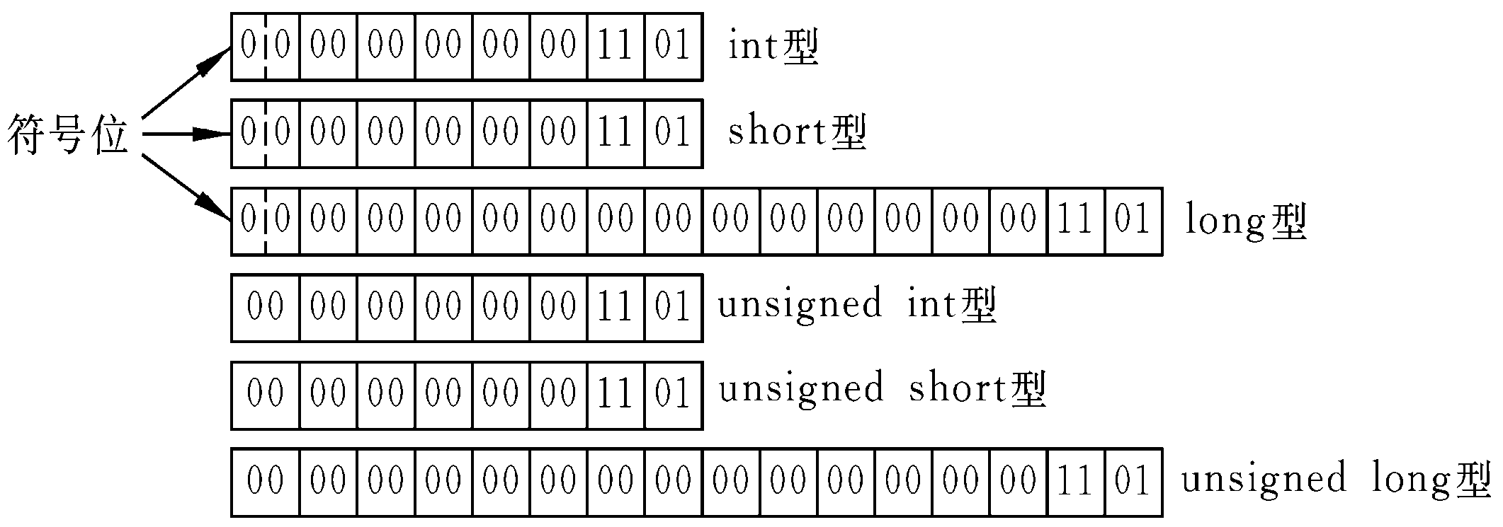
For example: The actual storage of the integer 13 in memory:

Slide 20
Overflow of integer numbers
square_int = 1440000
square_short = -1792
120000
square = 1515098112
An example (overflow.c)
#include<stdio.h>
int main()
{
int num =1200, square_int = num *num;
short int square_short = square_int;
printf("square_int = %d\n",square_int);
printf("square_short = %d\n",square_short);
scanf("%d",&num); /* reading an integer from keyboard*/
square_int = num *num; /* square*/
printf("square = %d\n",square_int );
return 0;
}

Slide 21
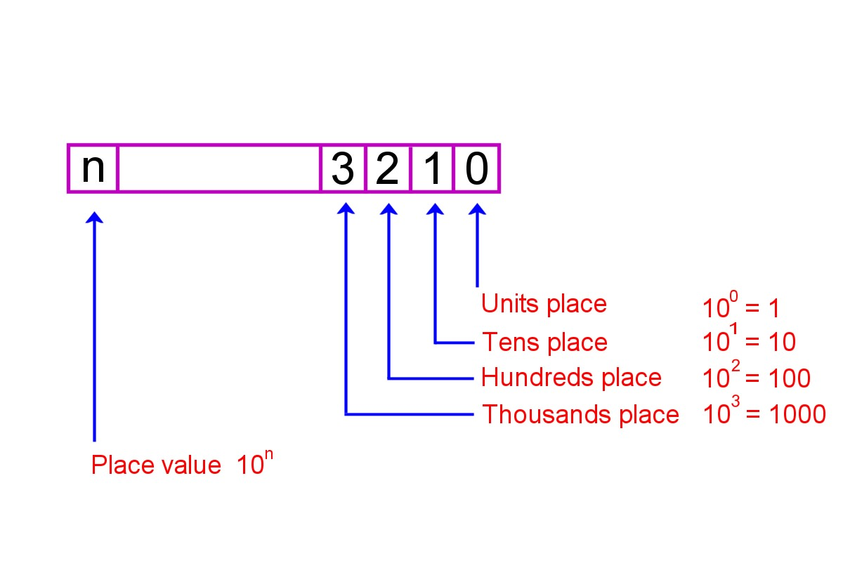
4.2 Integer type
How to convert decimal numbers to binaries?
The decimal, also known as the denary or base 10 numbering system is what we use in everyday life for counting.
The fact that there are ten symbols is more than likely because we have 10 fingers.
Those numerals are 0, 1, 2, 3, 4, 5, 6, 7, 8 and 9
Placeholder Value in the Decimal Numbering System

Slide 22
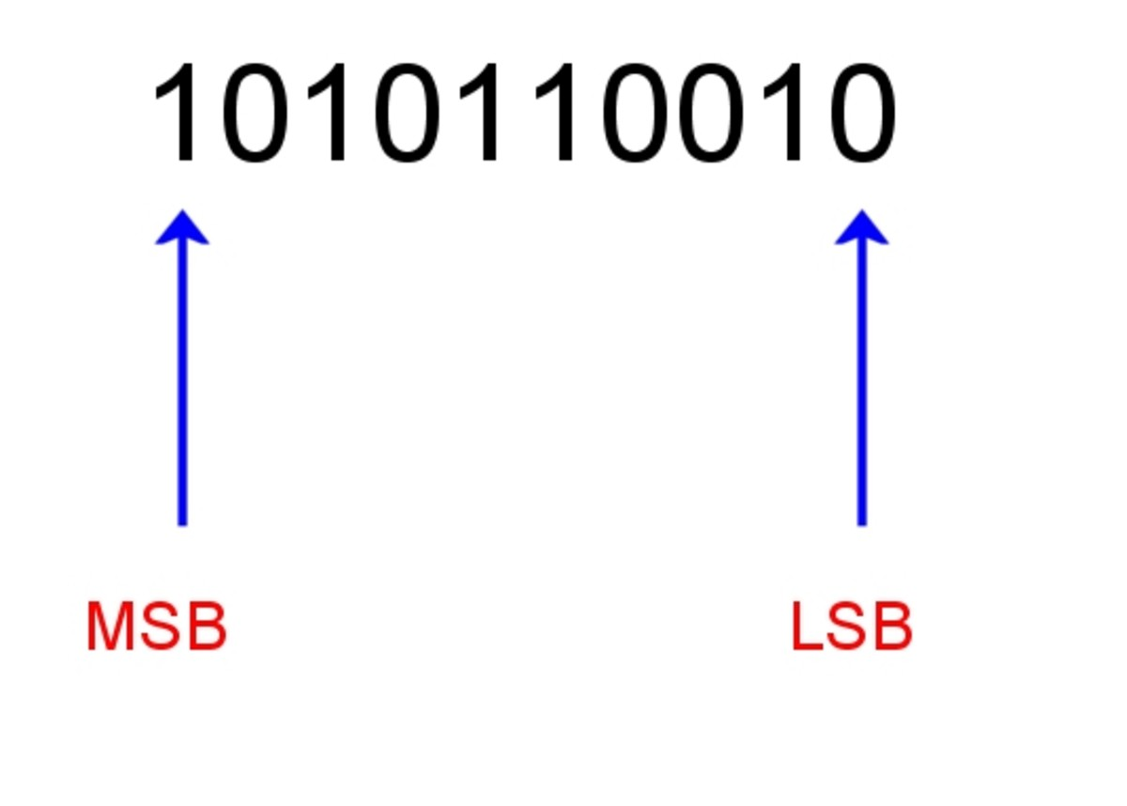
4.2 Integer type
Binary numeral system: represent numeric values using two symbols, 0 and 1.
Place holders in binary each have a value of powers of 2.
In binary we count 0, 1 and then since there's no numeral for two we move onto the next place holder so two is written as 10 binary.
This is exactly the same as when we get to ten decimal and have to write it as 10 because there's no numeral for ten.
Most Significant Bit (MSB) and Least Significant Bit (LSB)
For a binary number, the most significant bit (MSB) is the digit furthermost to the left of the number and the least significant bit (LSB) is the rightmost digit.

Slide 23
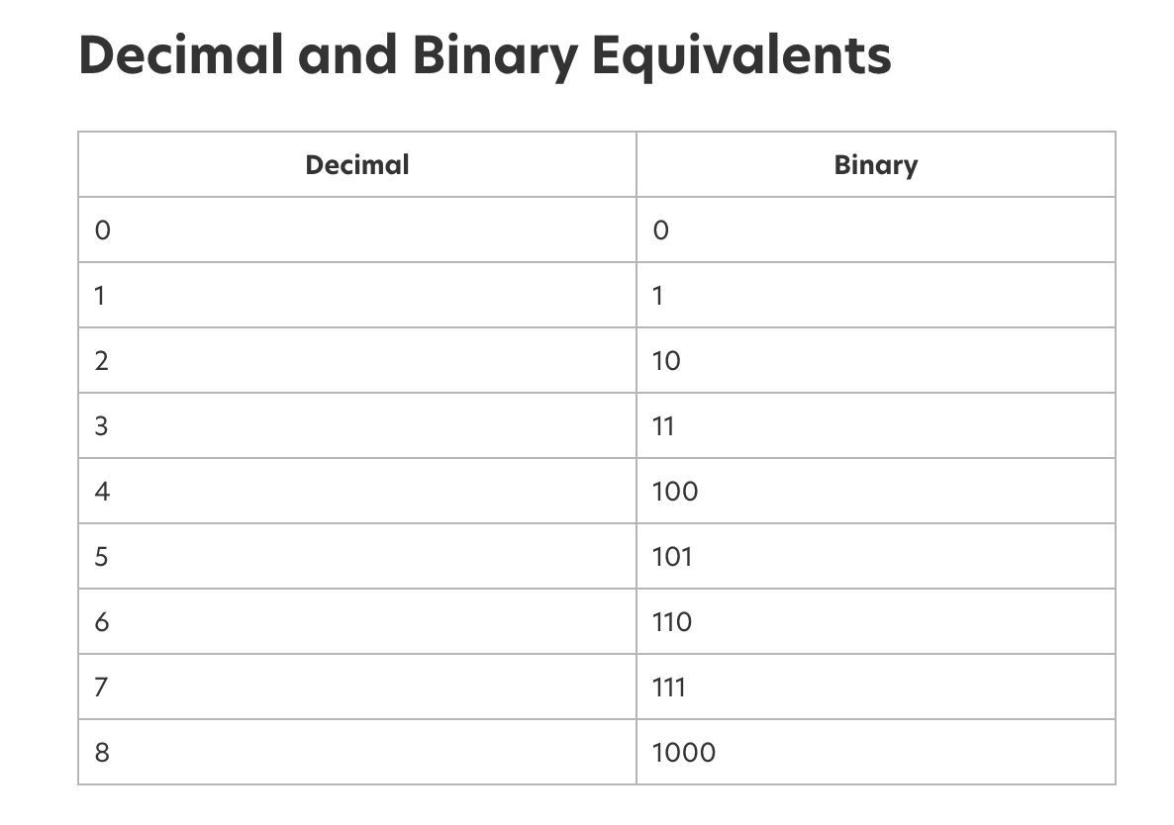
4.2 Integer type

Slide 24
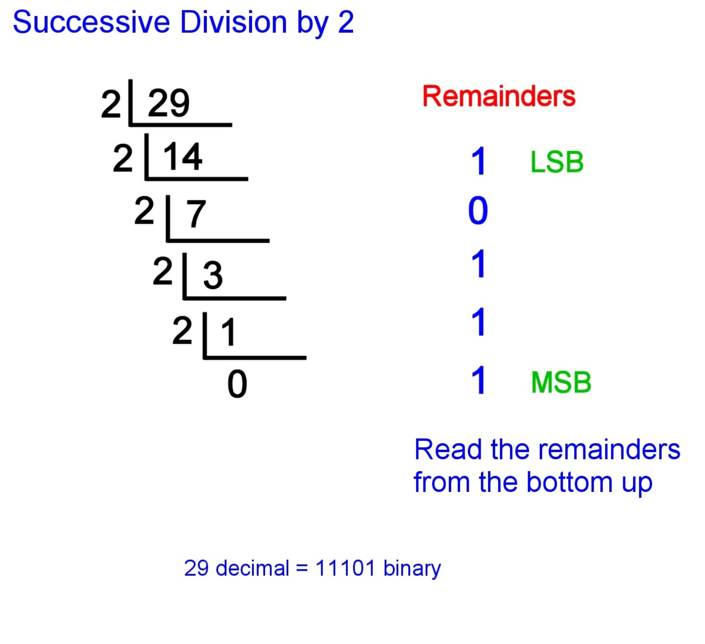
Binary representation for integers
Steps to Convert from Decimal to Binary
This involves dividing the number by 2 recursively until you're left with 0, while taking note of each remainder.
The most significant bit (MSB) is at the bottom of the column of remainders and the least significant bit (LSB) is at the top.
Notes:
This involves dividing the number by 2 recursively until you're left with 0, while taking note of each remainder.
Write down the decimal number.
Divide the number by 2.
Write the result underneath.
Write the remainder on the right hand side. This will be 0 or 1.
Divide the result of the division by 2 and again write down the remainder.
Continue dividing and writing down remainders until the result of the division is 0.
The most significant bit (MSB) is at the bottom of the column of remainders and the least significant bit (LSB) is at the top.
Read the series of 1s and 0s on the right from the bottom up. This is the binary equivalent of the decimal number.

Slide 25
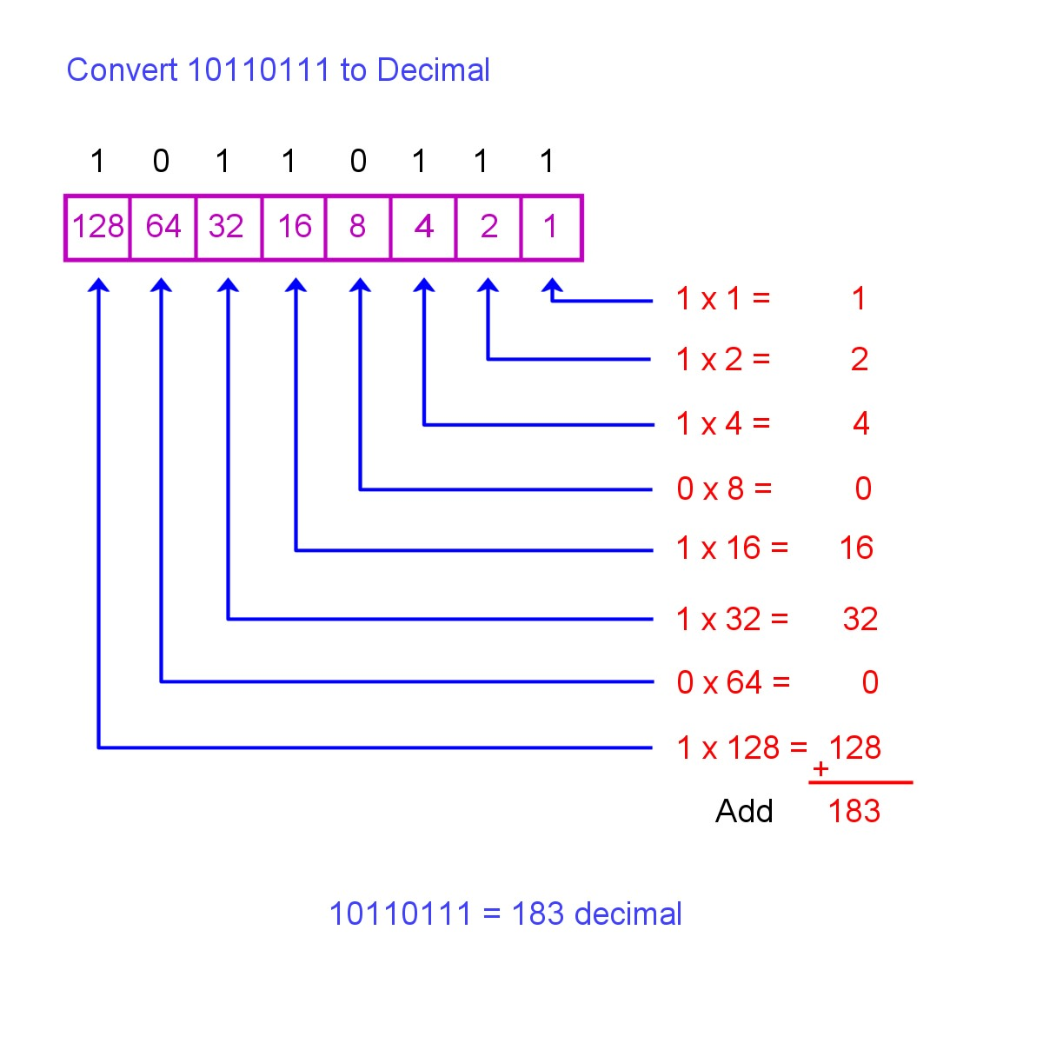
4.2 Integer type
Steps to Convert Binary to Decimal
Write down the number.
Starting with the LSB, multiply the digit by the value of the place holder.
Continue doing this until you reach the MSB.
Add the results together.
Notes:
Converting from binary to decimal involves multiplying the value of each digit (i.e. 1 or 0) by the value of the placeholder in the number

Slide 26
Exercise 1
Test Yourself!
What is 548 in binary?
What is 11111111 in decimal?
Notes:
1000100100
255

Slide 27
4.2 Integer type
Two's complement is the most common method of representing signed integers on computers
The two's complement is calculated by inverting the digits and adding one.
e.g. If we do not use Two's complement:
( 1 ) - ( 1 ) =( 1 ) + ( -1 )= (00000001)+ (10000001) -----------------原码计算
= (10000010)= ( -2 )
原码变反码：
正数的反码=其本身
负数的反码: (-1) (10000001 )原 11111110(反) 符号为不变
反码变补码：
整数的补码：其本身
负数的补码就是对反码加一
下面是补码的运算:
( 1 )- ( 1 )= ( 1 )+ ( -1 )
=(00000001)补+ (11111111)补(反码加一)
= (00000000)补= ( 0 )正确
负数的补码到源码：
-1后按位取反 符号位不变(-1) = (10000001)原码=(11111110 )反码 =((11111110 )+ 1)补码
( 1 )- ( 2)= ( 1 )+ ( -2 )
= (00000001)补+ (11111110)补
= (11111111)补= ( -1 ) 正确

Slide 28
4.2 Integer type
Two’s complement: makes addition for positives work for negatives
Express the binary value for the positive number (modulus)
If the original value is negative, complement the value and add one
Replicate the most significant bit (MSB, sign bit) to achieve the proper number of bits
i = -10;
Eight-bit signed integers
Decimal value | Two's-complement Representation
0 | 0000 0000
1 | 0000 0001
2 | 0000 0010
126 | 0111 1110
127 | 0111 1111
−128 | 1000 0000
−127 | 1000 0001
−126 | 1000 0010
−2 | 1111 1110
−1 | 1111 1111
1
1
1
1
1
1
1
1
1
1
1
1
1
0
0
0
1
1
1
0
1
0
1
0

Slide 29
Exercise 2
2-4=?

Slide 30
00000010(原)-00000100(原)
=00000010(原)+(10000100) (原)
=(00000010) (反)+(11111011) (反)
=(00000010) (补)+(11111100) (补)
=11111110 (补)
=11111101(反)
=10000010(原)=-2

